Slide 1

Classification of Oil Wells in the DSEATS Field Using Machine Learning
Team Name: Pioneers
Team Members
Name: Udoh Chigozie M.
SPE Number:
SPE Section:
Technical Area:
Name: Other Guys
SPE Number:
Category: Young Professional
Technical Area:
Name: Abdulateef Adedoyin Adeyemi
SPE Number: 4977464
SPE Section: Lagos Section
Technical Area: Reservoir Engineering

Slide 2
Outline
Problem Overview
Research on the Problem/Dataset
Brief Introduction to Machine Learning
Types of Machine Learning
Time Series Forecasting
Machine Learning Approach to the Problem
Machine Learning Flow
Data Cleaning
Exploratory Data Analysis (EDA)
Feature Engineering
Data Splitting
Modeling
Hyperparameter Tuning
Model Testing and Selection
Prediction Results

Slide 3
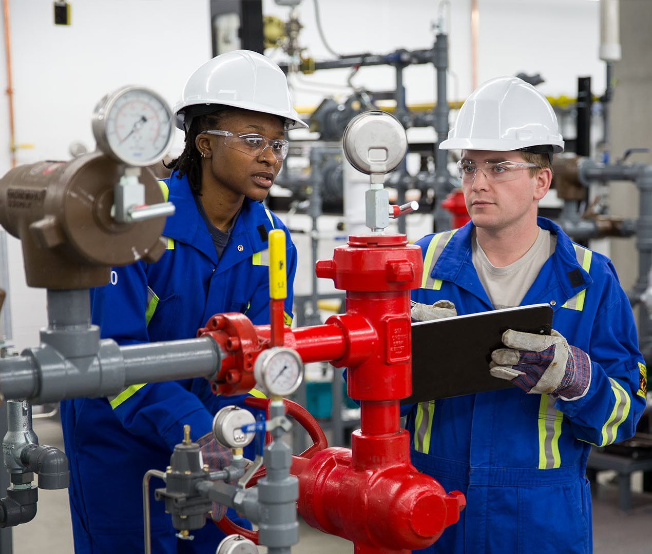
Problem Overview
Accurately classifying oil wells that produce oil, gas, and water plays a vital role in optimizing production strategies and enhancing resource management in the oil and gas industry. The objective was to implement a standard machine learning (ML) workflow to classify multiple wellbores based on seven key criteria: producing reservoir, reservoir type, lift type, flow type, gas-oil ratio (GOR) trend, water cut trend, and production index trend. This approach involves leveraging reservoir characteristics, historical production data, and well-specific parameters.

Slide 4




Experimental Data Analysis
Step 2
Study of Well and Reservoir Data
Empirical Solution
The provided reservoir and well data was examined to determine what data would be most important to the solution we needed to find.
Having arranged the data in a highly practical manner. Empirical solution for the classification were developed by applying core reservoir engineering principles. These solutions were guided by the predefined constraints and instructions that were outlined in the project expectations.
Understanding Features in the Dataset
Gained an understanding of parameters and how they influence well and reservoir classifications. E.g.
Features | Description
Total and Formation Gas production | Comparison of total gas produced and formation gas produced can give insights to type of lift.
Initial and Bubble point pressure | Comparison of initial pressure and bubble point pressure can give insights.
Step 1
Step 3

Slide 5
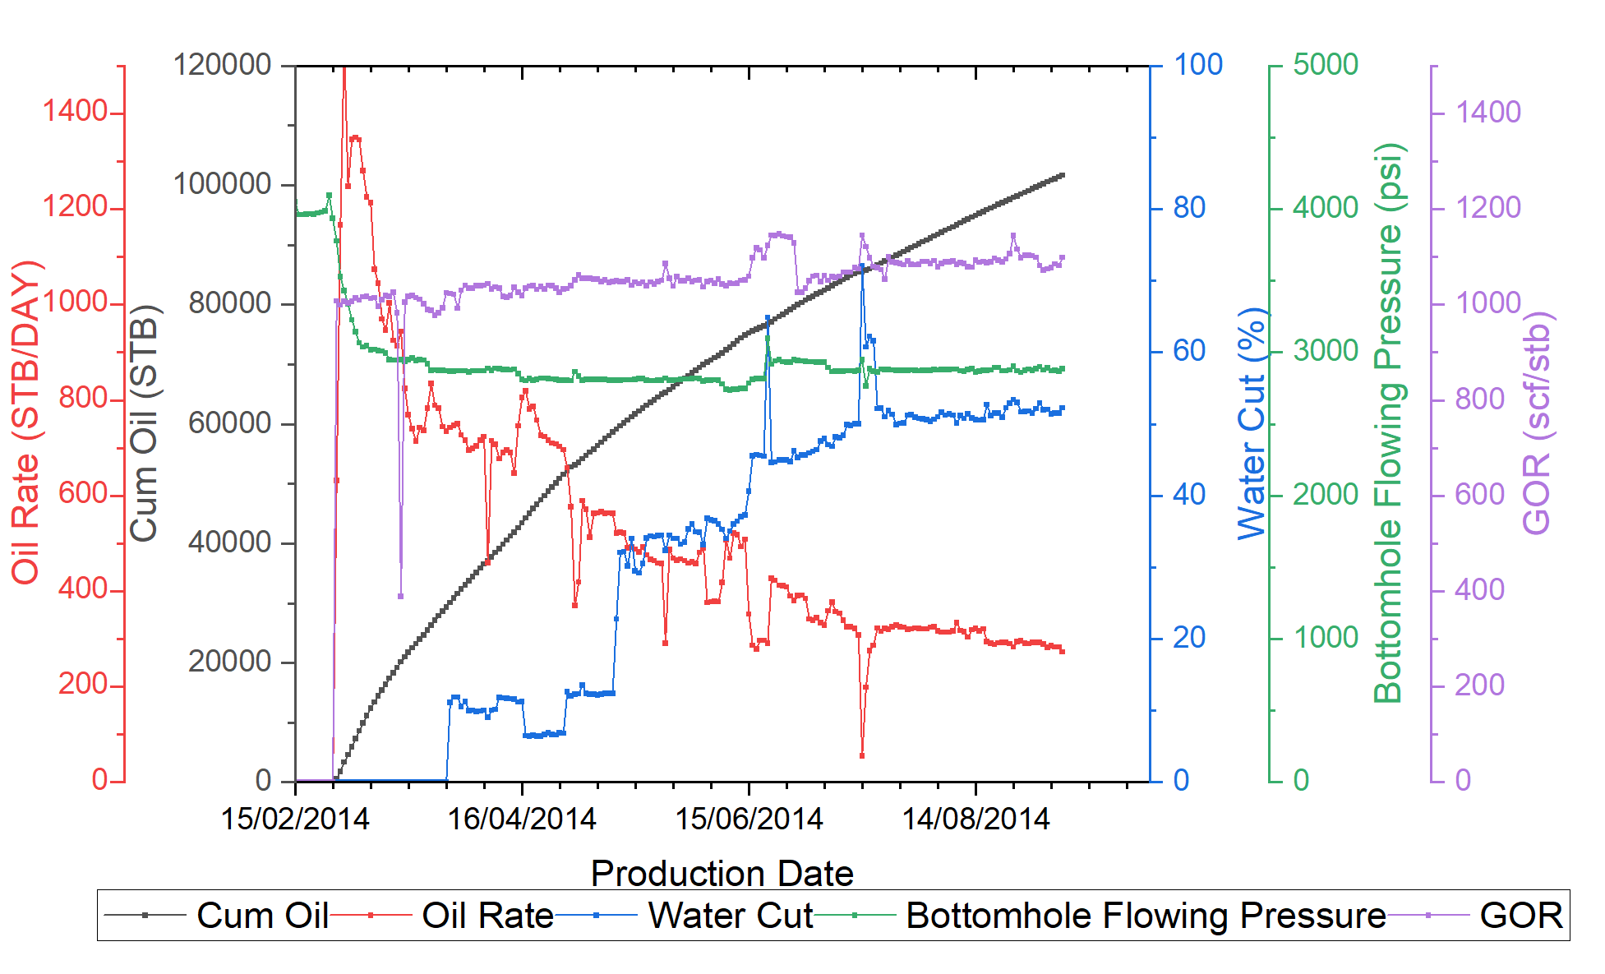
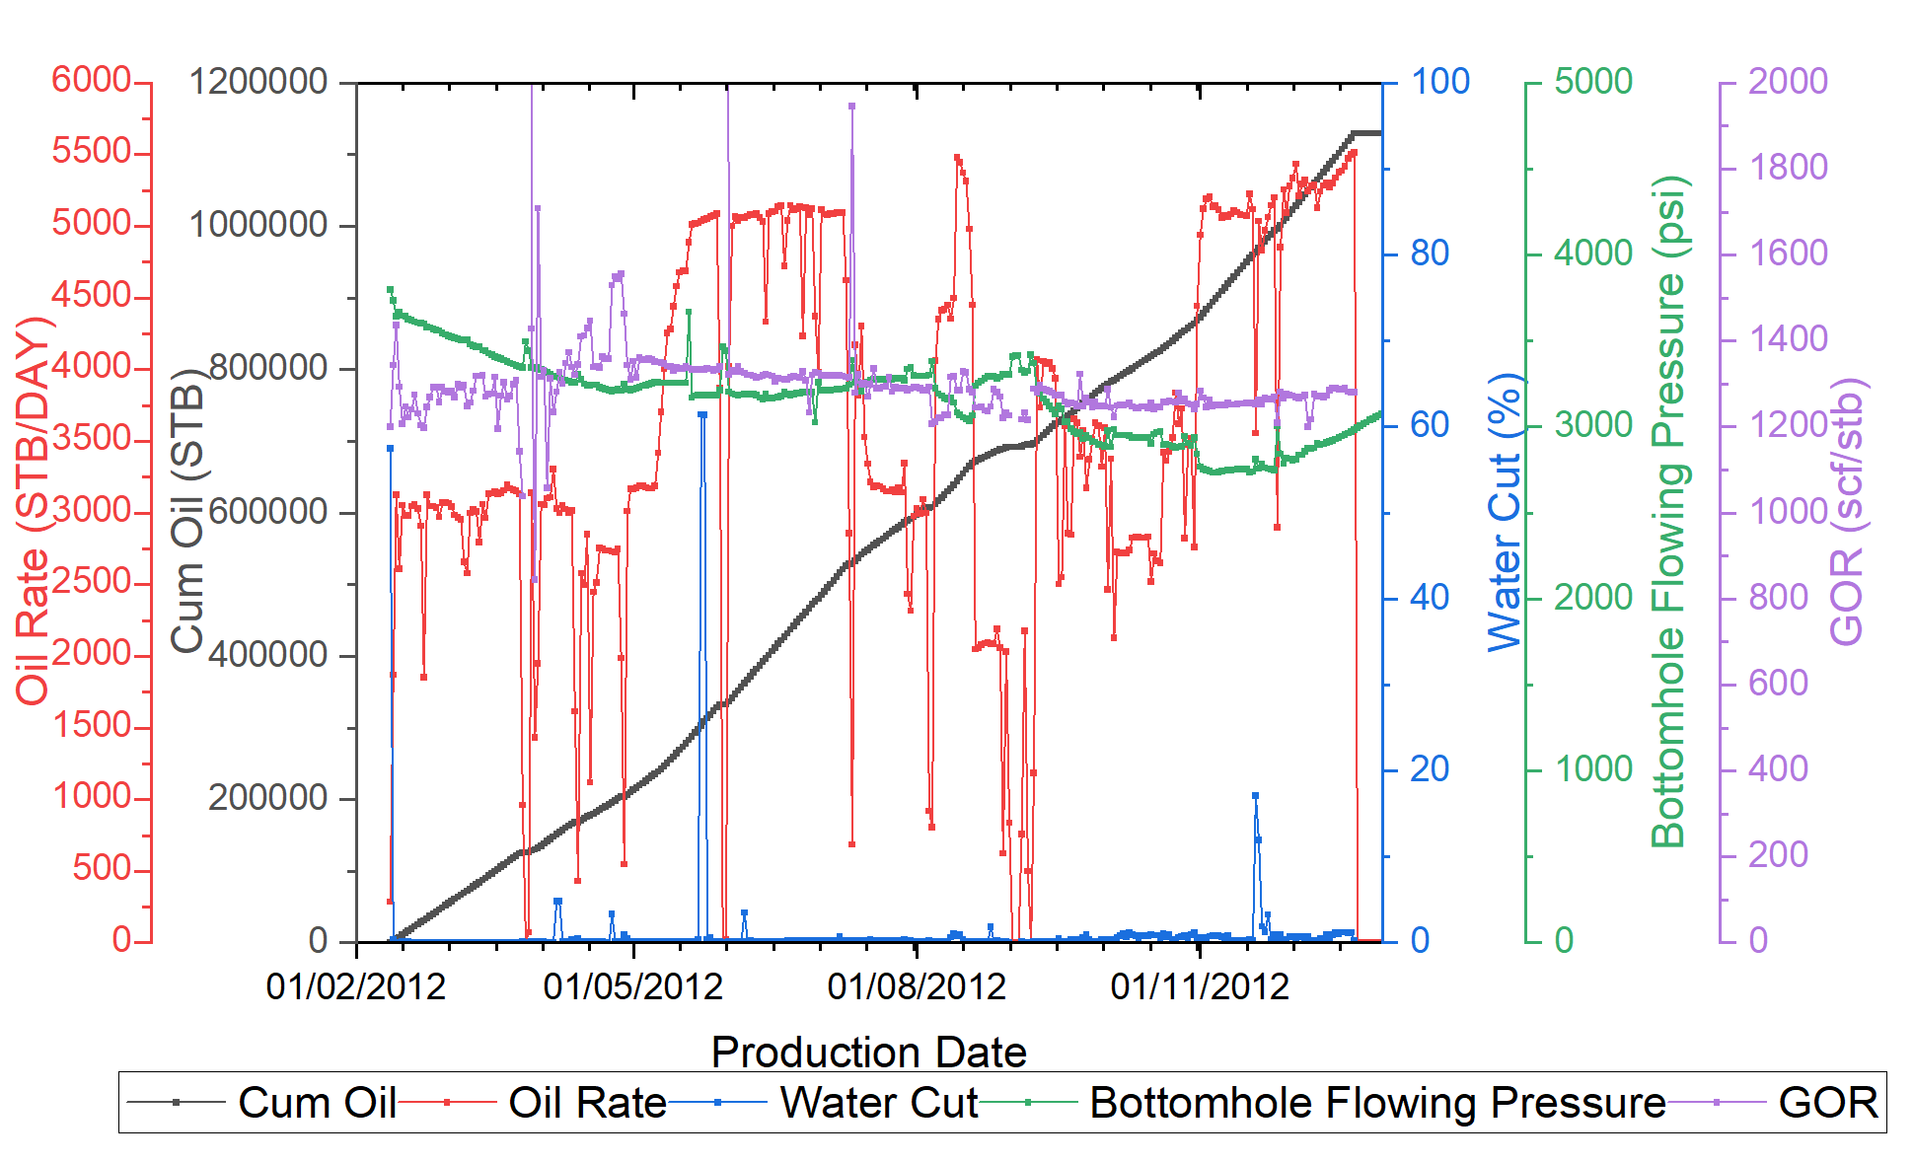
Experimental Data Analysis
Well 1 production profile Plot
Well 6 production profile Plot

Slide 6

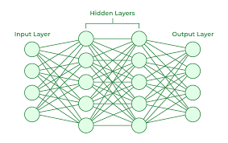
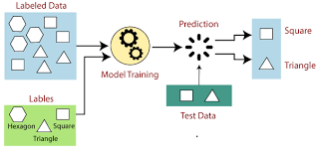

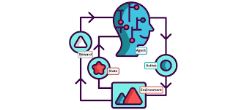
Brief Intro to Machine Learing
Machine learning is a powerful tool that enables computers to learn from data and make predictions or decisions without being explicitly programmed.
a
Subfield (Deep Learning)
1
2
3
Deep Learning is a subset of machine learning that utilizes neural networks with many layers to model and understand complex patterns in data.
Supervised Learning
Unsupervised Learning
Reinforcement Learning
Supervised learning is a machine learning approach where the model is trained on labeled data. It learns to map inputs to outputs based on example input-output pairs.
Unsupervised learning is a type of machine learning that involves training a model on data without labeled responses. This approach allows the model to discover patterns and relationships within the data on its own. It is popularly know as “Clustering”
Reinforcement Learning (RL) is a type of machine learning where an agent learns to make decisions by performing actions and receiving feedback in the form of rewards or penalties.

Slide 7
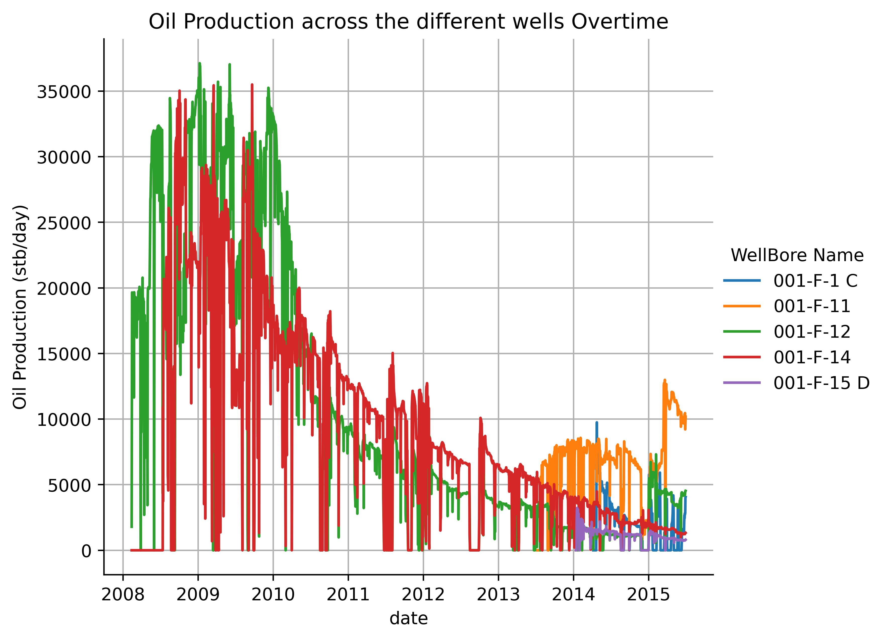
Brief Intro to Machine Learing
In Line with Problem – Brief Intro to TimeSeries in ML
Since the Problem involved Predicting “Future” production rates. It is best Categorized as a timeseries forecasting problem. Time series forecasting involves predicting future values based on previously observed data points collected over time.
Timeseries can be handled using various methods:
Timeseries models: These models use a window approach towards learning and there are specific models and algorithms for this purpose. E,g, Arima, Facebook Prophet, LSTM deep learning architecture, Recurrent Neural Network (RNN) architecture.
Timeseries as Supervised Learning: This involves extracting time related features such as day, year, week as features and also performing lag of features to use as new features with normal supervised learning models.

Slide 8
Machine Learning Flow
OVERVIEW
Data Cleaning
EDA and Outlier Removal
Feature Engineering
Data Splitting
Establishing Baseline (Gilberts Equation)
Modelling
Predictions

Slide 9

Machine Learning Flow
Data Cleaning and EDA
Consistency Check: Ensuring single name to denote a category e.g. a well having name in both upper and lower case in different rows.
DataType Confirmation: Numeric columns were changed to float datatype.
Handling Missing Values: Forward filling was employed to fill missing values.
Duplicates Check: Involved scanning for duplicate rows. No duplicate rows were found.
Insights from EDA
Category | Insight
Date | The Train data spanned 2008 – 2015
Well | 5 wells bores were given. With F-12 and F-14 having the oldest dates 0f 2008 (perhaps the oldest wells)
Gas-Oil Ratio (GOR) | Average GOR across all wells is 791.335

Slide 10

Machine Learning Flow
Feature Engineering
In line with handling timeseries as supervised learning, the below features were engineered towards better modelling;
1. Time based: Year, dayofyear, day, week.
2. Lag based: 1 to 5 days lag of Anulus pressure, choke size and well head pressure.
Data Splitting
Being a timeseries problem the data was split into training and testing in a sorted way as opposed to splitting randomly in non-timeseries problems.
The middle 12.5% and end 12.5% days for all wells were used as test data and the rest as training and validation during model tuning.

Slide 11


Results
Prediction Results
Total Historical Productions
Models Tested
KMeans
RandomForest Classifier (Used )
Model Tuning
- SVR was tuned using Bayesian optimization to find the best hyperparameters
- The ANN was tuned to find the best architecture (number of layers, learning rate, etc) and was saved. The ANN was seeded in prediction to ensure reproducibility.
WellBore Name | Oil Production (stb/day) | Gas Volume (scf/day) | Water Production (stb/day)
001-F-1 C | 903,421.13 | 747,540,025.13 | 625,605.79
001-F-11 | 4,877,046.79 | 4,113,850,478.09 | 1,266,428.29
001-F-12 | 28,006,034.73 | 22,870,038,821.08 | 39,963,852.90
001-F-14 | 24,443,457.60 | 20,096,495,901.37 | 37,634,006.58
001-F-15 D | 596,353.33 | 499,500,129.80 | 12,979.67
Total= | 58,826,313.58 | 48,327,425,355.45 | 79,502,873.22
Total Forecasted Productions
WellBore Name | Oil Production (stb/day) | Gas Volume (scf/day) | Water Production (stb/day)
001-F-1 C | 340,952.44 | 246,657,654.08 | 419,362.71
001-F-11 | 2,151,065.21 | 1,702,776,080.88 | 3,998,442.23
001-F-12 | 364,857.46 | 263,432,108.85 | 11,073,104.42
001-F-14 | 564,530.78 | 440,438,938.72 | 8,027,352.76
001-F-15 D | 230,265.23 | 150,216,928.98 | 455,991.34
Total= | 3,651,671.13 | 2,803,521,711.51 | 23,974,253.46

